Slide 1
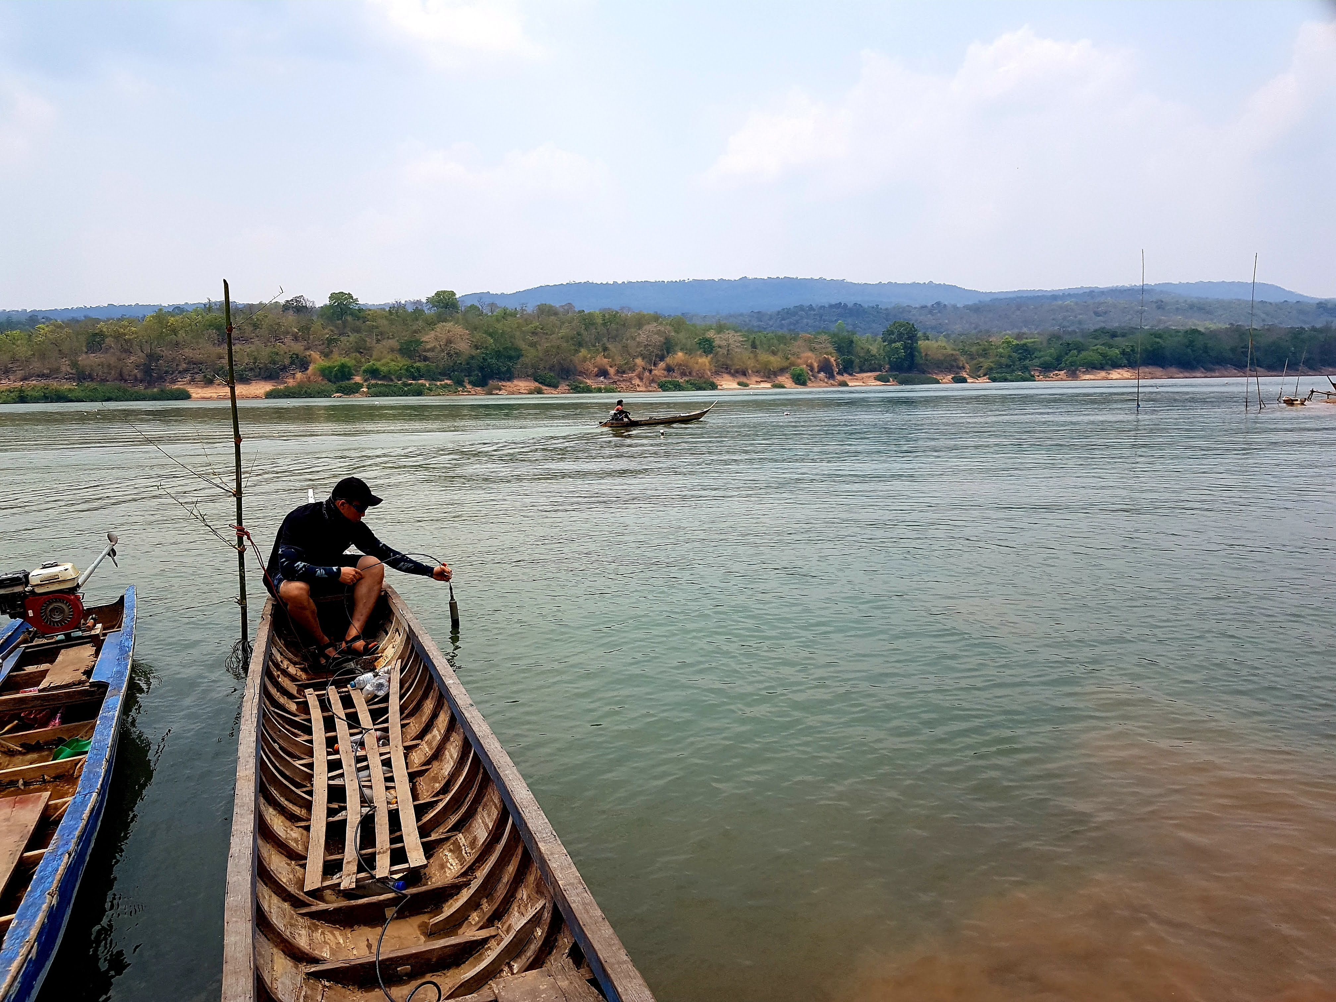

Evaluation of climate change impact on seasonal biogeochemical variations in the Mun River watershed using water quality data and geochemical mass balance method
Supanut Suntikoon¹, Schradh Saenton^{1,2}
¹Environmental Science Research Center, Faculty of Science, Chiang Mai University, Chiang Mai, 50200 THAILAND ²Department of Geological Sciences, Faculty of Science, Chiang Mai University, Chiang Mai, 50200 THAILAND
November 2024
Notes:
Good morning, everyone. My name is Supanut Suntikoon from Chiang Mai University, and today, I’m excited to share our study on evaluating the climate change impacts on seasonal biogeochemical variations in the Mun River watershed. This research combines water quality analysis with a geochemical mass balance method, aiming to shed light on the intricate interplay between natural processes and human activities in this vital region of Thailand. Let's dive into the details!

Slide 2
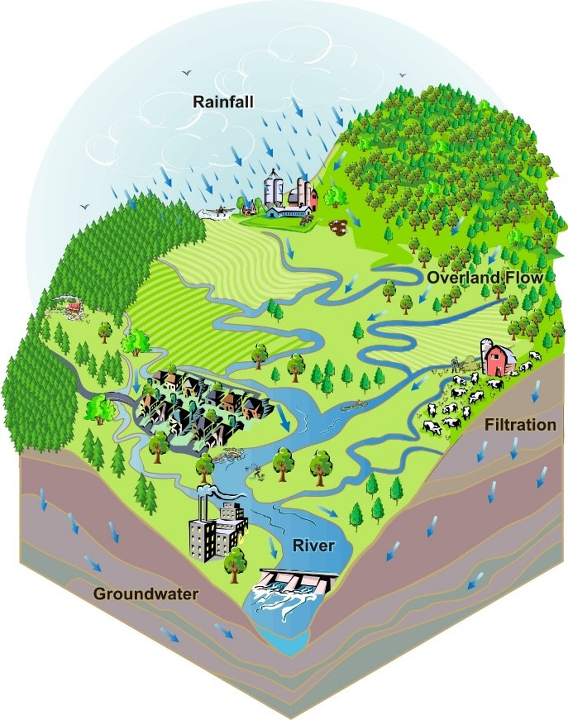
Research Question
Background
Methods
Modeling
Results
Conclusions
How do biogeochemical cycles in the Mun River watershed vary between the dry and wet seasons?
How do human activities, such as agriculture and deforestation, interact with natural geological processes to affect water quality?
How might future changes in temperature and precipitation patterns intensify existing water quality challenges in the watershed?
What role do mineral weathering and biomass degradation play in the carbon cycle within the Mun River watershed?
Notes:
Our research focuses on some fundamental questions. First, how do biogeochemical cycles in the Mun River watershed change between the dry and wet seasons? Next, how do human activities like agriculture and deforestation interact with natural geological processes to affect water quality? We’re also looking at how future climate changes, such as shifts in temperature and rainfall, could exacerbate these challenges. Finally, we explore the roles of mineral weathering and biomass degradation in the carbon cycle within the watershed. Answering these questions will help us tackle critical challenges in watershed management and sustainability.

Slide 3
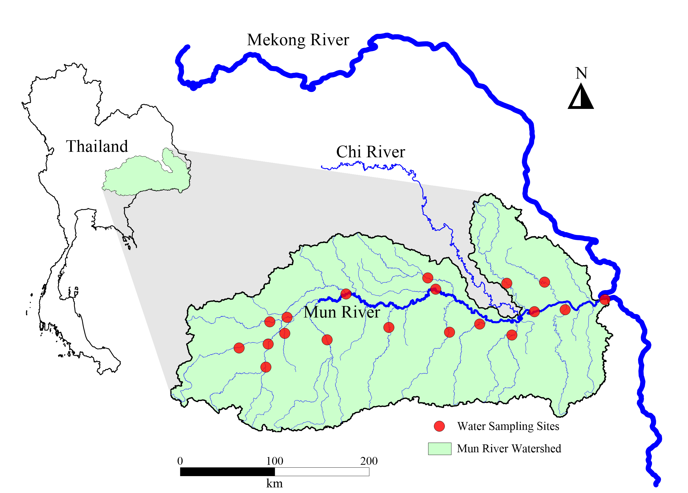
Background
Methods
Modeling
Results
Conclusions
Mun River Watershed
Total Area: ~71,000 km² (significant portion of Northeastern Thailand).
River Length: ~900 km from its source to the confluence with the Mekong River.
Annual Rainfall: ~1,200–1,300 mm/year, concentrated in June–October.
Annual Discharge: ~26 billion m³ flows into the Mekong at Ubon Ratchathani.
Agricultural Role: Crucial for irrigating extensive rice paddies.
Seasonal Variability: Peak flow in rainy season; significant drop in dry season.
Notes:
Here, we’re zooming in on the Mun River watershed, a critical tributary of the Mekong River. This basin supports agriculture, fisheries, and livelihoods across northeast Thailand. However, the region faces significant environmental stressors—declining water quality and quantity, intensifying land use changes, and the looming impacts of climate change. Understanding this watershed's biogeochemical cycles is essential for developing sustainable solutions.

Slide 4
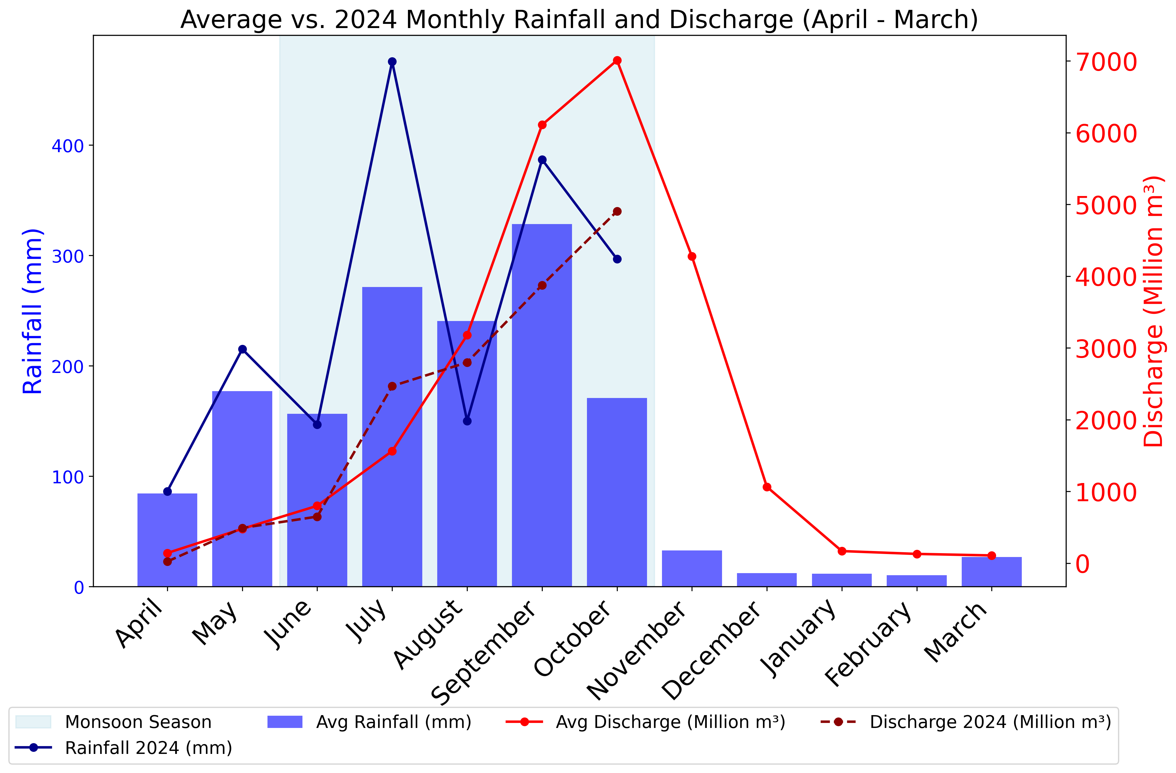
MRW Climate
Background
Methods
Modeling
Results
Conclusions
Distinct wet and dry seasons.
Monsoonal rains dominate June–October (rainy season).
Majority of annual precipitation (~80%) occurs in the rainy season.
Data source: Hydro-4.com
Notes:
The Mun River basin experiences a distinct tropical monsoonal climate. About 80% of annual rainfall occurs during the rainy season, from June to October. The rest of the year is predominantly dry, creating pronounced seasonal contrasts in hydrology. These climate patterns drive significant variations in river discharge, sediment transport, and nutrient cycling. Climate projections suggest an increase in temperature and rainfall variability, further complicating water resource management. This is why studying this watershed’s seasonal dynamics is so critical.

Slide 5

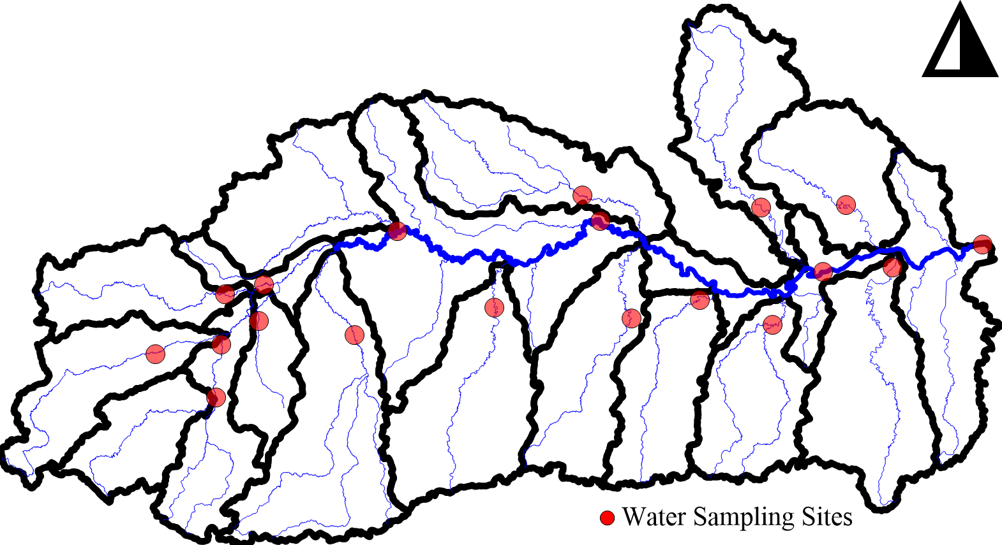
Field Methods
Background
Methods
Modeling
Results
Conclusions
Seasonal Sampling: Conducted during both dry and wet seasons to assess seasonal variability in water chemistry.
Strategic Site Selection: Samples collected from upstream, midstream, and downstream locations to capture spatial variability in the Mun River basin.
Parameters Measured: Analyzed for major ions (e.g., Na⁺, K⁺, Ca²⁺, Mg²⁺, Cl⁻, HCO₃⁻, SO₄²⁻, NO₃⁻) and nutrients (e.g., silica).
Instrumentation: Used YSI multiparameter probe for in-situ measurements, including pH, temperature, dissolved oxygen, and conductivity.
Flux Calculations: Integrated water discharge data to determine the fluxes of dissolved species.
Lab-Based Analyses: Conducted precise quantification of ions and nutrients to understand their seasonal and spatial distribution.
Notes:
To capture seasonal variability, we conducted field sampling during both the dry and wet seasons. Sites were strategically selected along upstream, midstream, and downstream sections of the river to reflect spatial heterogeneity. Water samples underwent lab-based analyses to quantify ions, nutrients, and dissolved species. Additionally, we incorporated river discharge data to calculate fluxes of dissolved species—crucial for understanding transport rates. These methods allowed us to link hydrological changes to biogeochemical cycles, building a comprehensive dataset.

Slide 6
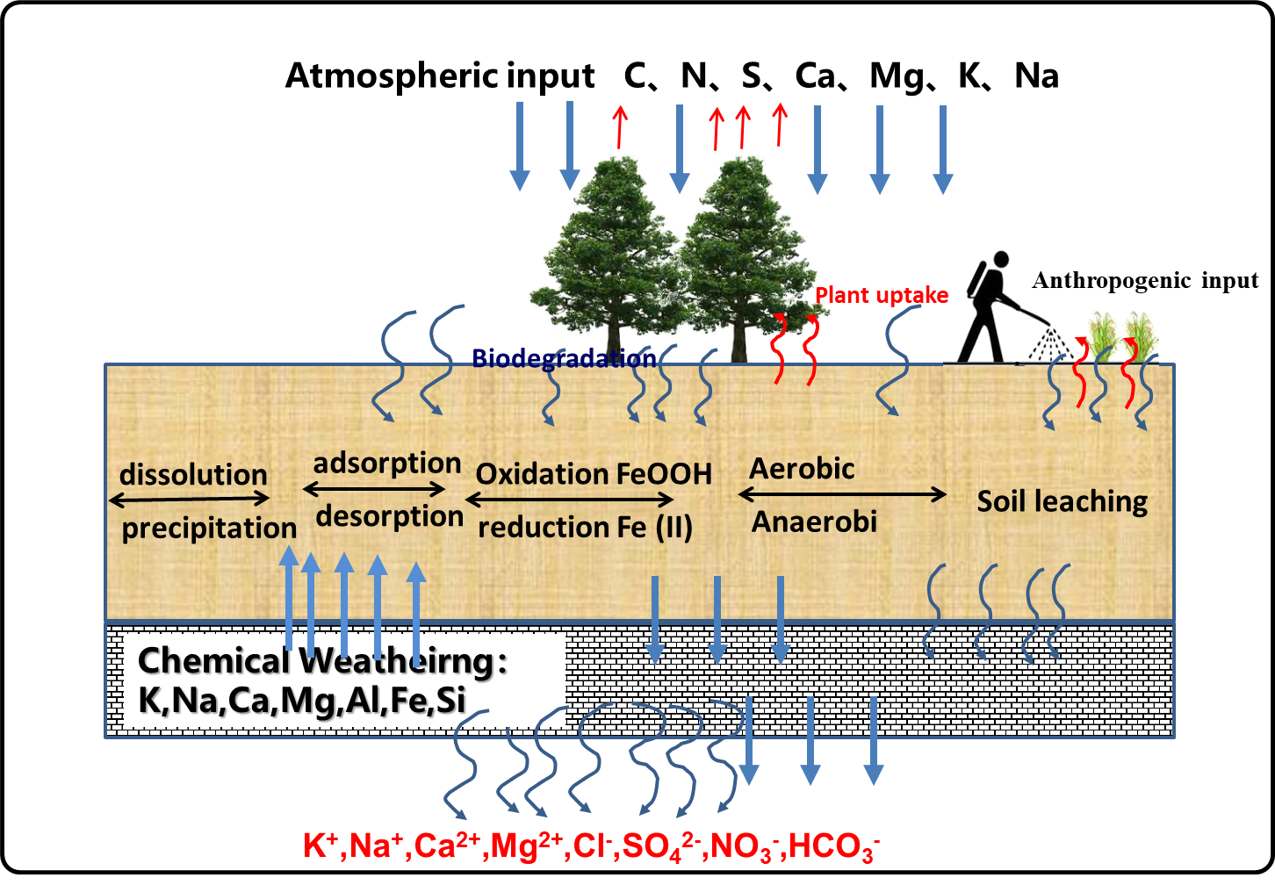
Geochemical Mass Balance Method
Background
Methods
Modeling
Results
Conclusions
Key Concepts
Quantifies mineral weathering and biomass degradation rates.
Tracks major dissolved ions (e.g., K⁺, Na⁺, Ca²⁺, Mg²⁺, Cl⁻, SO₄²⁻, NO₃⁻, HCO₃⁻).
Processes Shown in Diagram
Chemical Weathering: Minerals dissolve, releasing ions.
Biodegradation: Organic matter breaks down, cycling nutrients.
Soil Leaching: Water transports dissolved ions to streams.
Applications
Combines field data and discharge to calculate fluxes.
Uses matrix (Ax = b) to solve for weathering and biomass rates.
Notes:
Our analysis utilized the Geochemical Mass Balance (GMB) method. This approach quantifies the inputs and outputs of dissolved species in a system, accounting for processes like mineral weathering, biomass degradation, and groundwater contributions. By applying GMB to the Mun River, we could quantify seasonal changes in biogeochemical fluxes with precision.
This diagram illustrates how the GMB method integrates various sources and sinks of dissolved materials to evaluate biogeochemical cycles.

Slide 7
GMB Model
Background
Methods
Modeling
Results
Conclusions
Goal: Calculate mineral weathering rates (α1–α6) and biomass degradation (α7).
Minerals: Quartz, Halite, Feldspar, Garnet, Biotite, Vermiculite.
Input Data:
Matrix A: Stoichiometric coefficients from XRD analysis.
Vector b: Measured fluxes of Na⁺, Mg²⁺, Ca²⁺, K⁺, and SiO₂.
Implementation:
Used PEST optimization to solve for all unknowns.
Output:
Mineral weathering rates and biomass degradation quantified per subwatershed.
Vermiculite
Feldspar
Biomass
Garnet
Quartz
Biotite
Halite
Notes:
Alright, let’s dive into the backbone of our analysis—the Geochemical Mass Balance (GMB) model. This approach provided us with a powerful framework to quantify dissolved species fluxes and unravel the underlying biogeochemical processes. The GMB method essentially builds a system of linear equations, represented as Ax = b. Here, 'A' is a matrix that captures geochemical and hydrological parameters, 'x' represents unknown fluxes such as contributions from mineral weathering and biomass degradation, and 'b' is the vector of observed dissolved concentrations from our field samples.
To solve this system, we used the PEST software—an advanced tool for parameter estimation. PEST applies optimization algorithms to find the best-fit solution for 'x', ensuring the calculated fluxes align with our observed field data. This iterative approach minimizes errors, providing highly accurate estimates for both individual and cumulative fluxes.
In addition to dissolved species like bicarbonates, sulfates, and nitrates, the GMB model also allowed us to incorporate biomass degradation as a significant contributor to carbon cycling. By including biomass in the mass balance equations, we were able to quantify its role alongside mineral weathering in driving the seasonal fluxes we observed.
The key strength of this approach lies in its ability to integrate multiple sources and sinks of dissolved species. It accounts for not just natural processes like mineral weathering but also anthropogenic influences such as agricultural runoff and deforestation. This level of precision is critical for understanding the seasonal variability in fluxes, as well as for designing management strategies to mitigate climate and land-use impacts on water quality.
Ultimately, by combining linear algebra with geochemical insights, the GMB model offered a comprehensive and scalable tool to capture the complexity of biogeochemical processes in the Mun River watershed.

Slide 8
Dissolved Fluxes
Background
Methods
Modeling
Results
Conclusions
The flux of dissolved species (Δ𝑚_{𝑐}) was calculated using the equation:
Precipitation
Soil Water
Fluxes (Δ𝑚_{𝑐}) were normalized by the cross-sectional area to standardize the transport rates.
Stream (Q_{t}C_{t} )
Area
Groundwater
Notes:
Dissolved fluxes were calculated using this equation, where the flux is a function of concentration, river discharge, and cross-sectional area. This method standardizes the transport rates across seasons, revealing critical patterns. For example, during the wet season, increased discharge amplifies the transport of dissolved species, whereas the dry season shows concentrated fluxes due to lower flow rates.

Slide 9
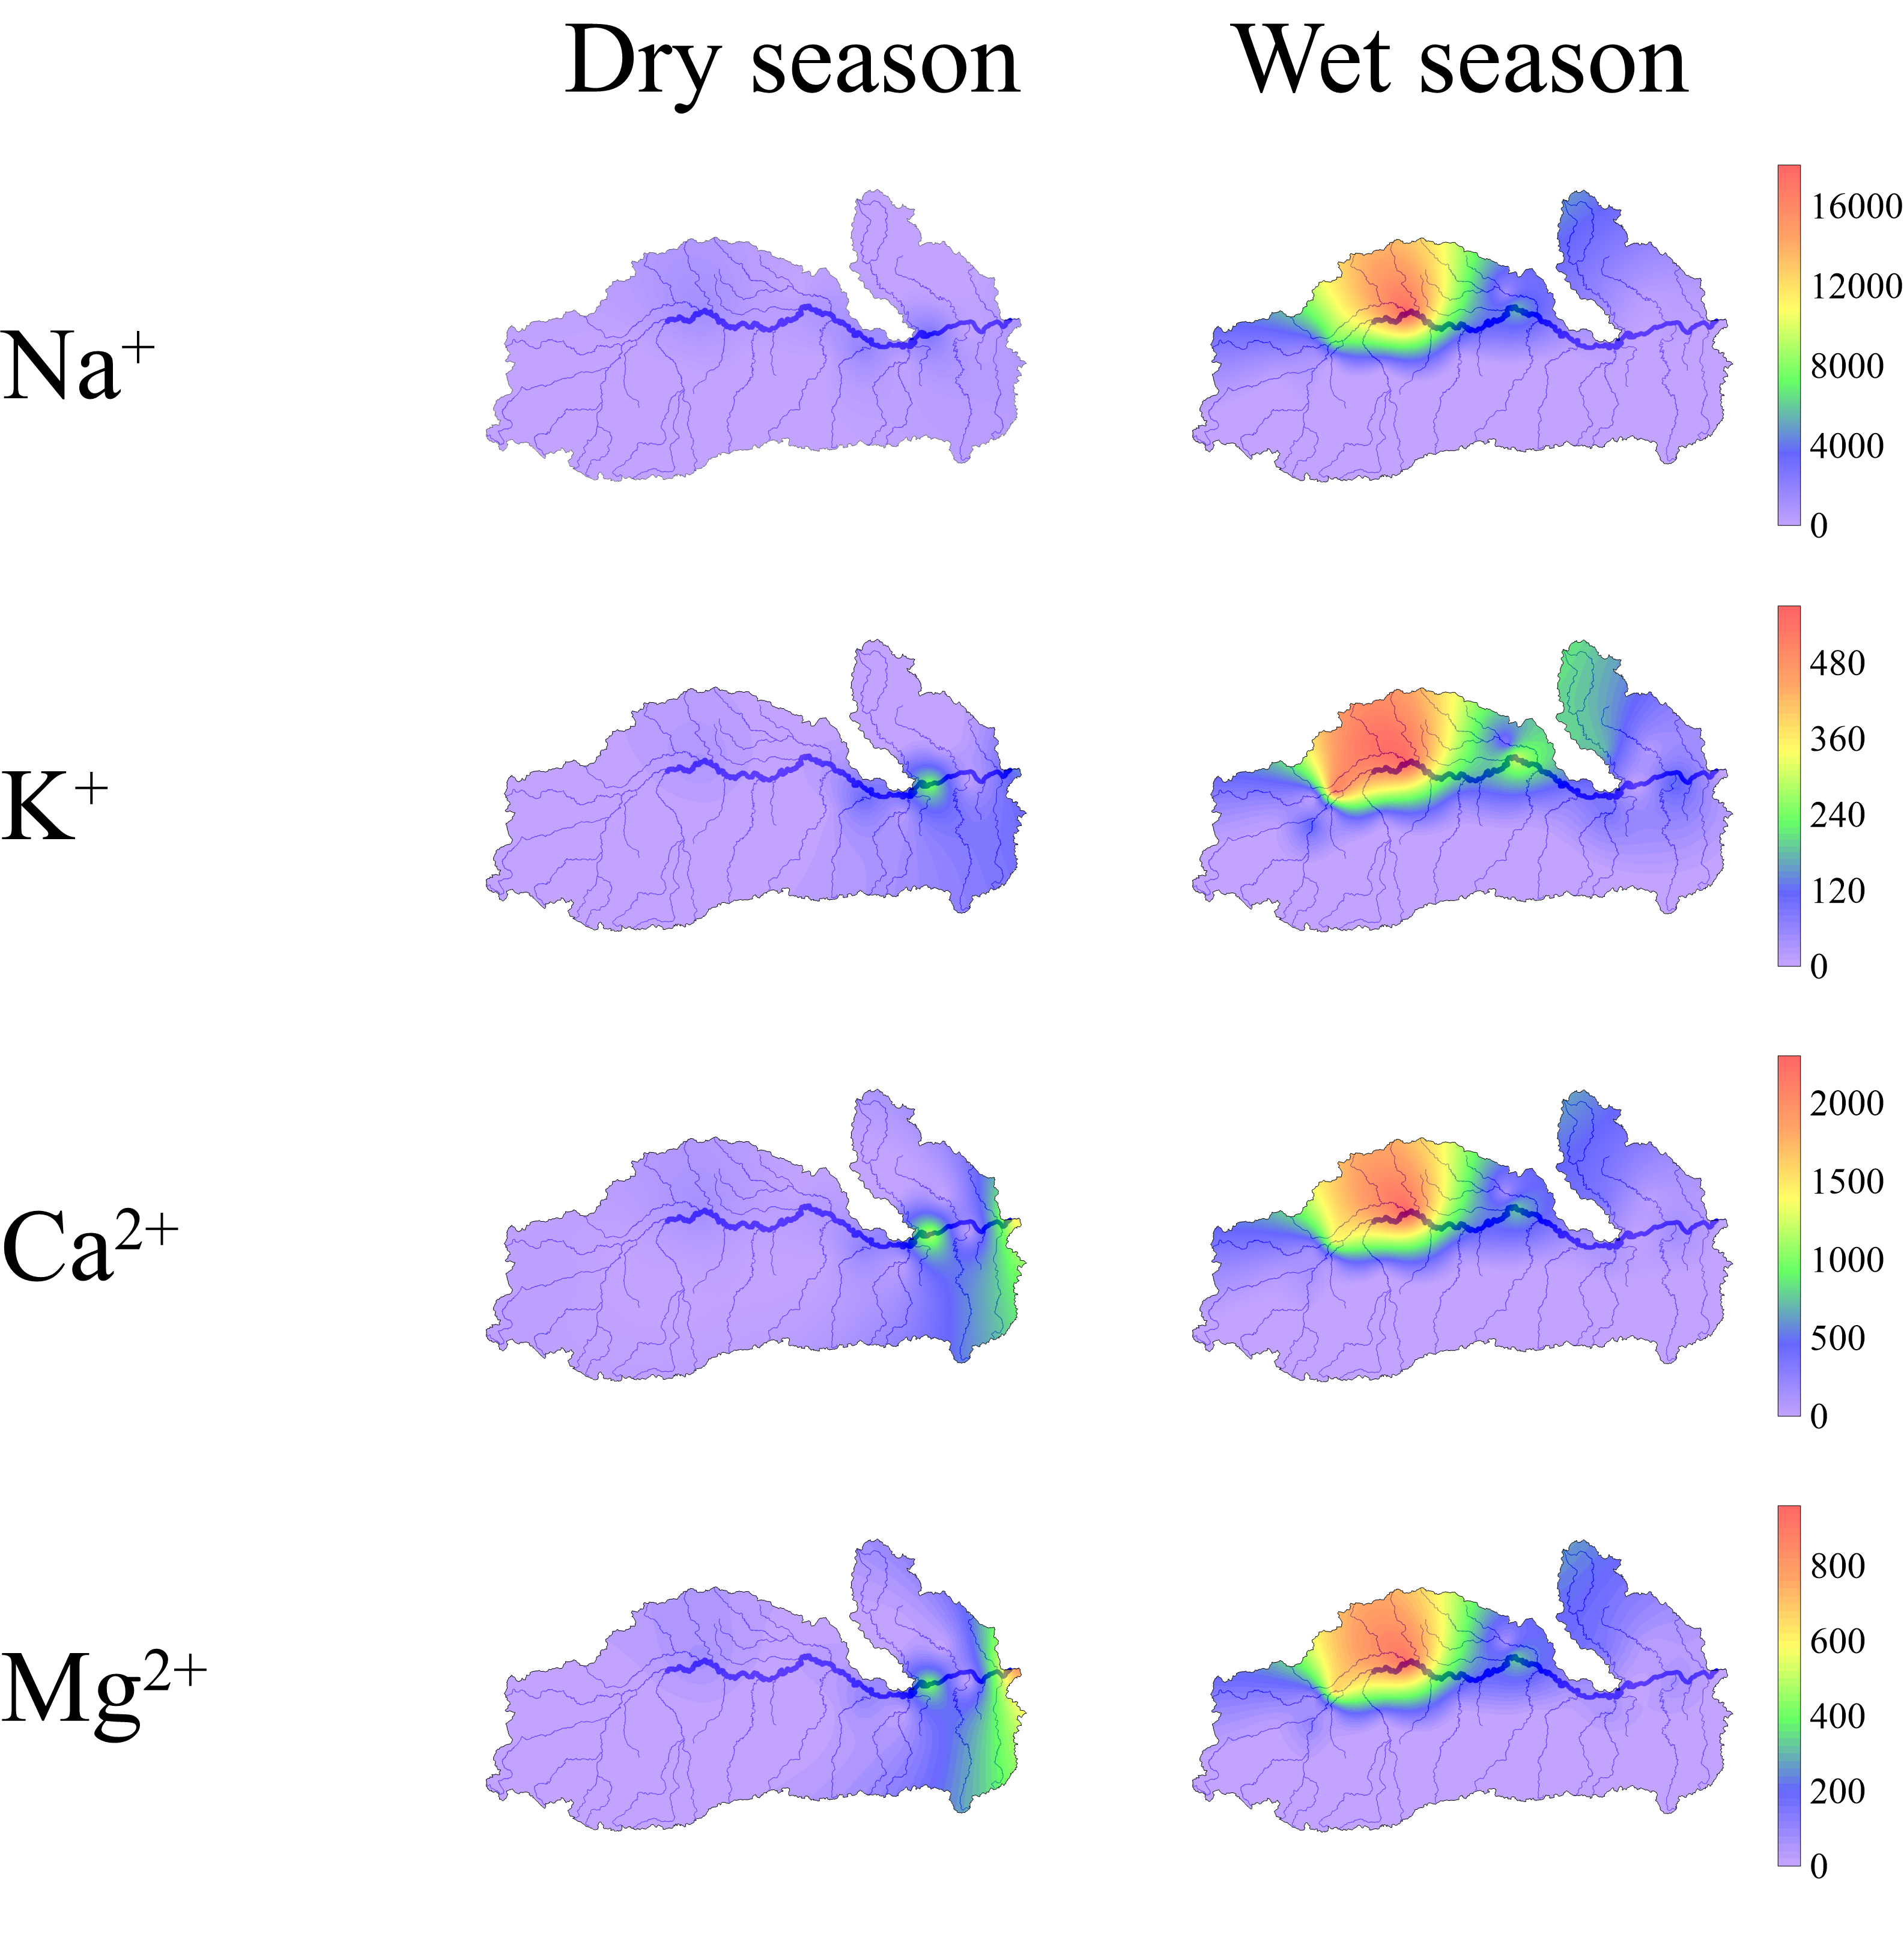
Results
Background
Methods
Modeling
Results
Conclusions
Seasonal Variation: Fluxes are much higher in the wet season, driven by increased discharge, showing the role of hydrology.
Spatial Patterns: Hotspots in northern subwatersheds suggest geological influence (e.g., evaporite dissolution) and anthropogenic inputs.
Implications: Enhanced weathering rates and solute transport during the wet season impact downstream water quality.
Notes:
Our results revealed significant seasonal shifts in dissolved fluxes. Wet season fluxes were dominated by elevated discharge, driving higher transport of dissolved species, especially in areas impacted by agriculture. Conversely, the dry season showed concentrated nutrient levels, highlighting the role of reduced flow in amplifying solute concentrations. These patterns underline the interconnectedness of hydrological and anthropogenic processes.

Slide 10
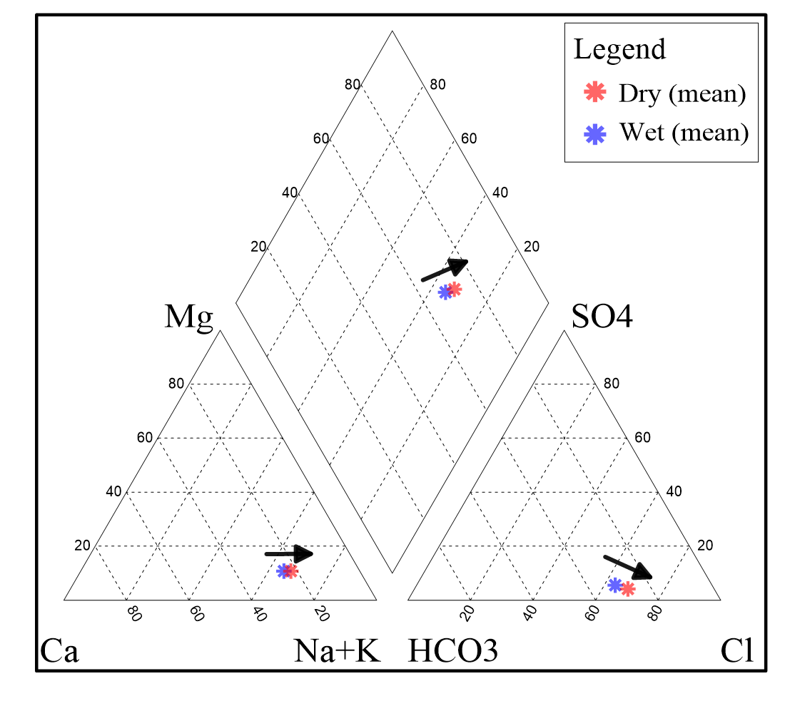
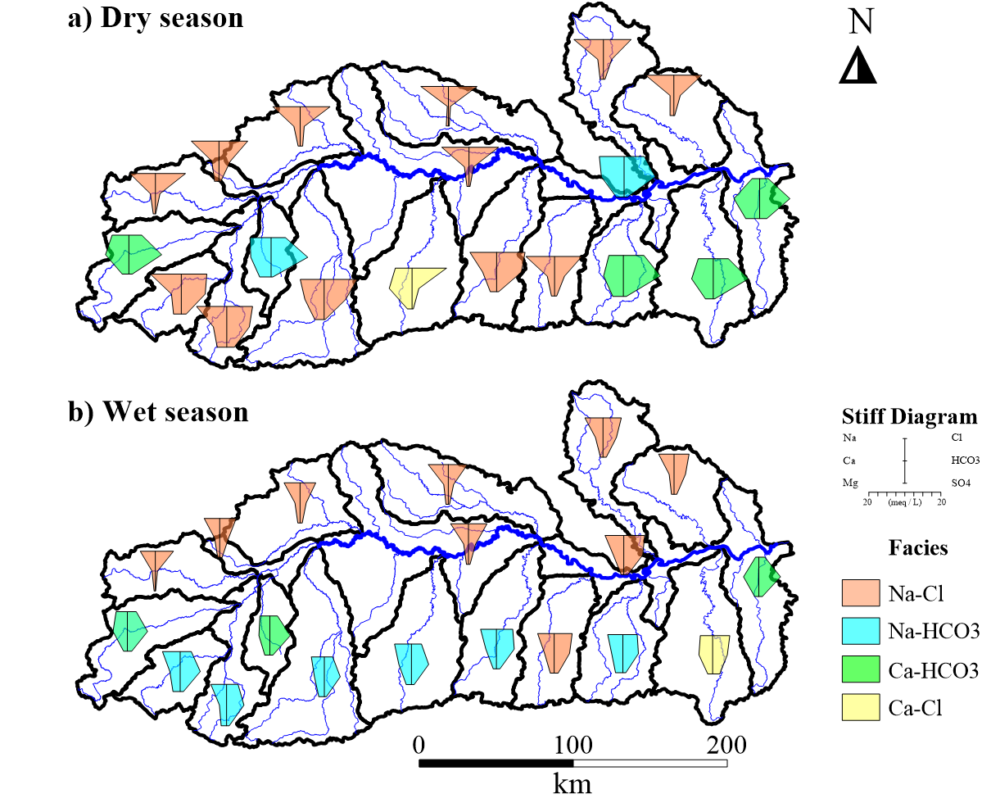
Hydrogeochemical Shifts
Background
Methods
Modeling
Results
Conclusions
Piper Diagram: Shift from pristine to contaminated water in the dry season due to higher ion concentrations.
Stiff Maps:
Dry season: Na⁺-Cl⁻ facies dominate (evaporation, human impact).
Wet season: Ca²⁺-HCO₃⁻ facies dominate (dilution, weathering).
Seasonal changes show hydrology and human activity influence.
Notes:
One of the standout findings was the shift in hydrogeochemical facies between seasons. During the dry season, Na-Cl water types dominated due to evaporite dissolution, while the wet season was characterized by Ca-HCO₃ facies, linked to increased carbonate weathering. These transitions reflect the dynamic interplay between geology, hydrology, and human activity.

Slide 11
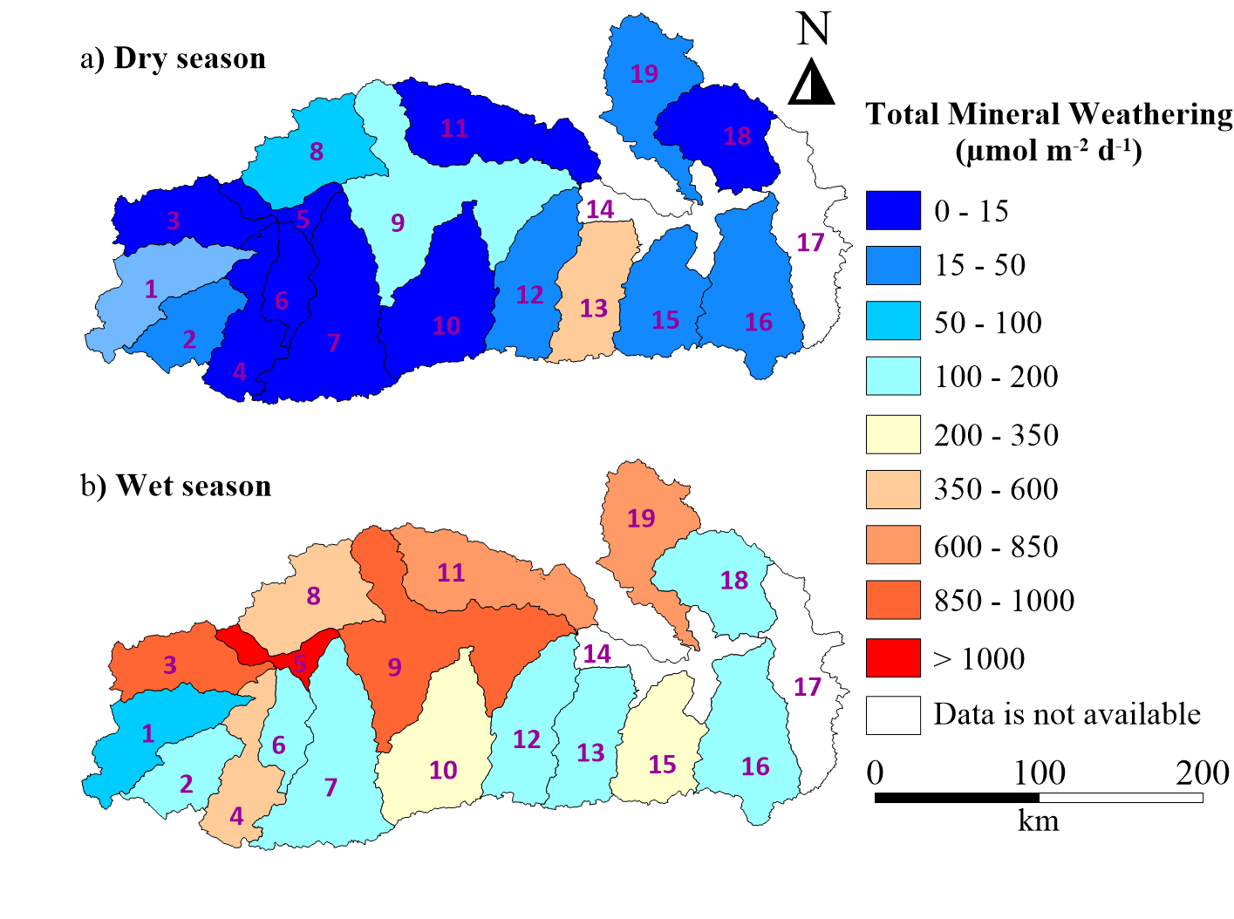
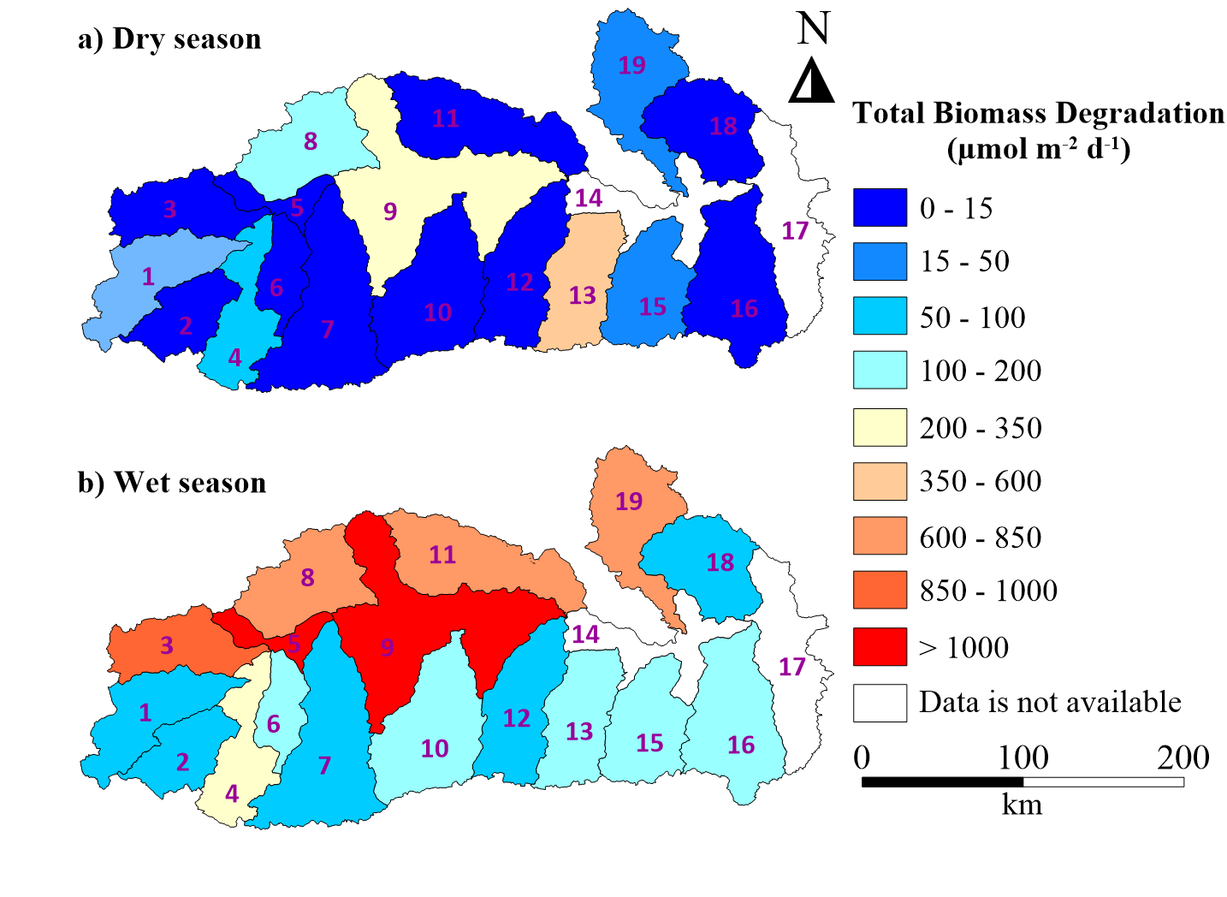
Weathering & Biomass degradation rates
Background
Methods
Modeling
Results
Conclusions
Spatial Variability: Rates vary across subwatersheds, driven by land use and lithology.
Northern Hotspots: Higher rates due to intense agriculture and weathering-prone rocks.
Southern Areas: Lower rates linked to forest cover and minimal human impact.
Key Drivers: Local geology, hydrology, and human activities shape these patterns.
Notes:
We also quantified weathering rates and biomass degradation, both of which play pivotal roles in carbon cycling. Weathering of silicate and carbonate minerals during the wet season showed higher rates, correlating with increased discharge and surface runoff. Biomass degradation also contributed to elevated nutrient fluxes, particularly in agriculturally dominated areas.

Slide 12

Conclusions
Background
Methods
Modeling
Results
Conclusions
Seasonal Flux Variations: Dissolved species fluxes are significantly higher in the wet season, highlighting the influence of hydrology and discharge on solute transport.
Hotspot Identification: Northern subwatersheds emerge as hotspots for dissolved species, driven by intensive agriculture and weathering-prone lithology.
Water Type Transition: Piper diagrams reveal a seasonal shift in water type, indicating increasing contamination during the dry season.
Weathering and Biomass Insights: Variations in weathering and biomass degradation rates across subwatersheds emphasize the impact of local geology, land use, and hydrology.
Future Management: These findings stress the need for adaptive watershed management to mitigate anthropogenic impacts and address climate-driven challenges.
Notes:
In conclusion, the Mun River watershed exhibits significant seasonal variability in dissolved fluxes, driven by hydrological changes. Wet seasons enhance solute transport due to higher discharge, while dry seasons concentrate dissolved materials. Agricultural practices and deforestation further amplify nutrient fluxes, underscoring the need for sustainable management. This study’s findings contribute to adaptive strategies for mitigating climate impacts and ensuring sustainable water resource management in the basin.

Slide 13
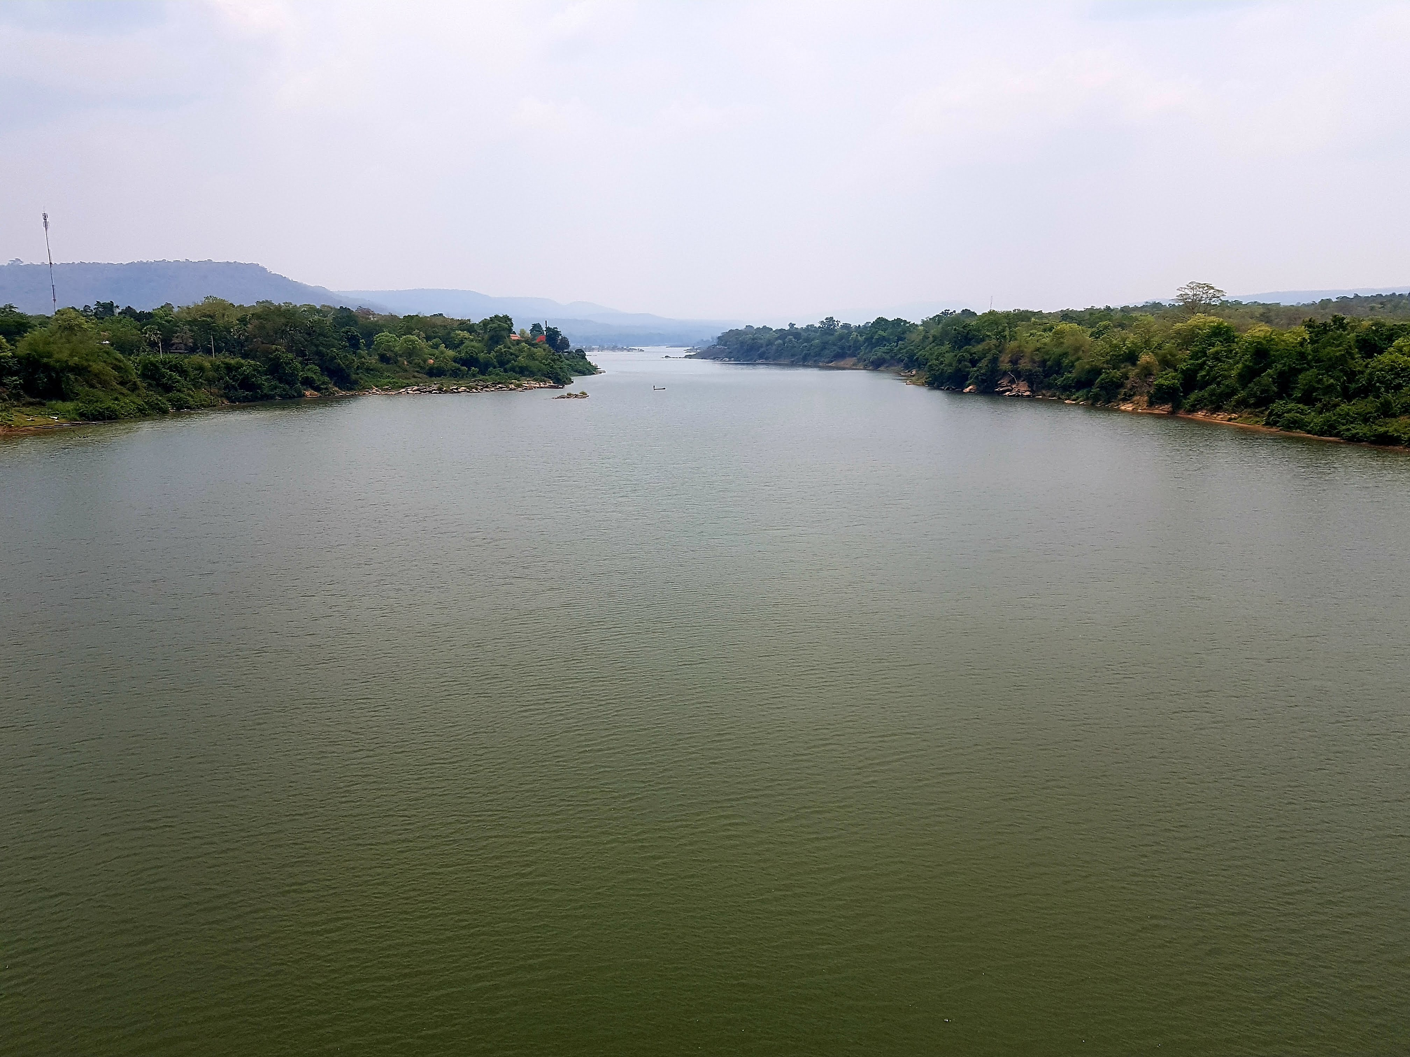
Questions?
Notes:
Thank you for your attention! I’m happy to take any questions or discuss your insights on this work.

